Slide 1
The Problem of Social Order
Rafael Marques

Slide 2
The Language of Social Order
Routines and Scripts.
Values and Social Norms, Codes and Laws.
Habits.
Education and Socialization.
The “Should” vs. the “Could”.
Compliance/Contrainte.
Regular Expectations, Regularities, and Analytical Frames.
Rights and Duties.

Slide 3
The Language of Social Order
Trust, Confidence, Distrust and Mistrust.
Local Orders – Social Arrangements.
Dramaturgical Orders.
Fear and Conformity.
Power, and Domination.
Fate, Hope, and Faith.
Us vs. Them.
Do ut des and Tit For Tat

Slide 4
The Language of Social Order
Justice, Equity, Toleration, Decency.
Reciprocity, and the Prospects of Retaliation.
Obligation and Citizenship.
Identity and Multiculturalism.
Homogeneous and Heterogeneous.
Imposing and Granting.
Fragmentation.
Discipline and Vigilance.

Slide 5
The Language of Social Order
Making Sense of Things.
Stable Predictions.
Policing and the Polis.
Whose Order?
Myths
Spontaneous, Anarchical, Regulated.
Solidarity, Cooperation, Collective Action.
Continuity and Change.

Slide 6
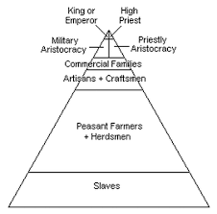
Types of Social Order

Slide 7
Social Order(s)

Slide 9
The Rational Contract

Slide 10
Classical Contractarians

Slide 11
Thomas Hobbes

Slide 12
John Locke

Slide 13
John Locke

Slide 14
John Locke

Slide 15
Rousseau

Slide 19
Hobbes vs. Rousseau

Slide 23
Private Vices – Public Benefits – The Road to the Invisible Hand https://www.youtube.com/watch?v=y-6qdHzSDug

Slide 24
Durkheim’s Solidarities

Slide 25
Divison of Labor

Slide 26
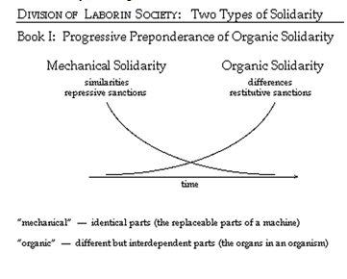
Sanctions

Slide 27
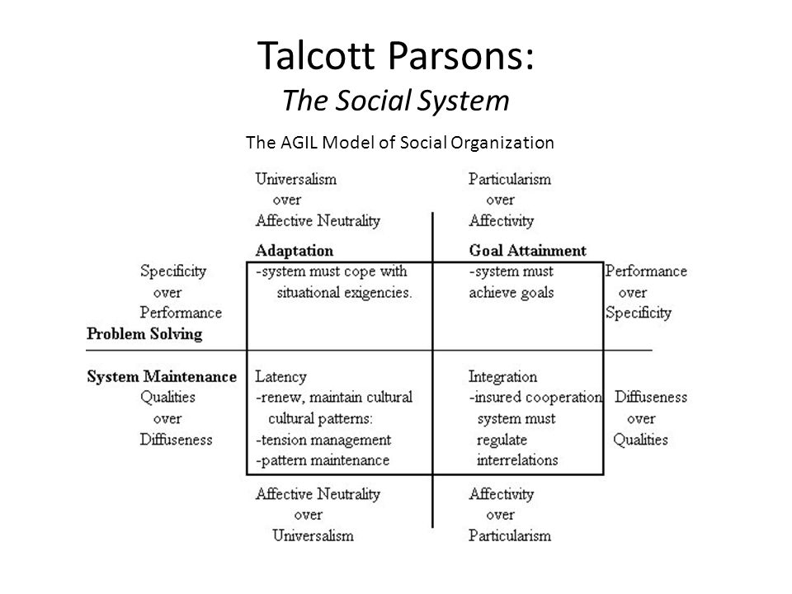
Talcott Parsons

Slide 28
Guaranteeing Social Order

Slide 29
Dependence and Control

Slide 31
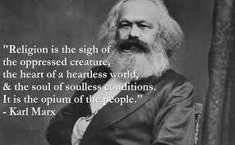
Marx’s View on Social Order

Slide 32
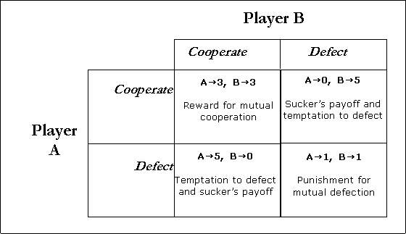
Axelrodian Cooperation

Slide 33
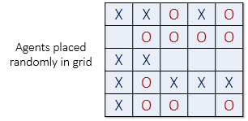
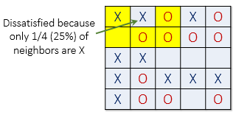
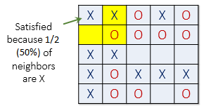
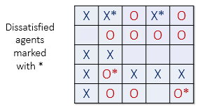
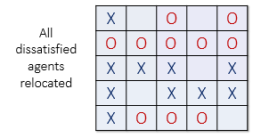
Schelling’s Model of Seggregation

Slide 34
Olson’s Problem

Slide 35
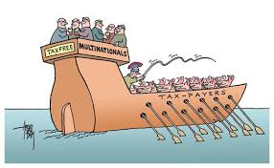
Collective Action Problems

Slide 36
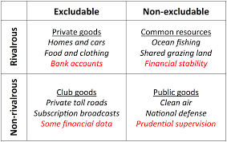
Types of Goods and Social Order

Slide 37
Weber’s Model of Domination

Slide 41
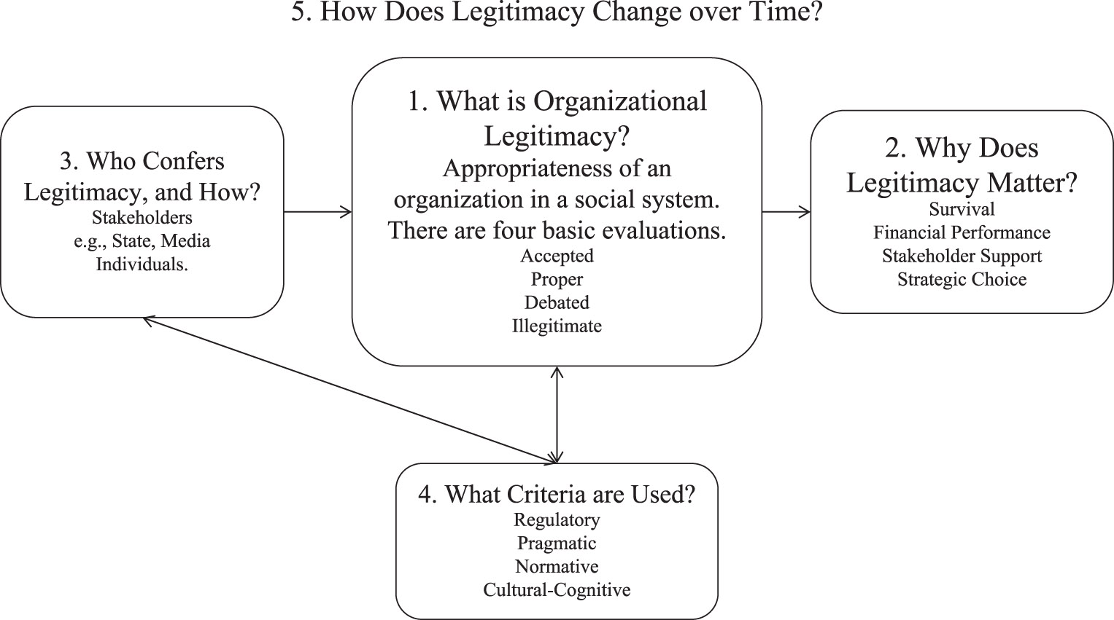
Issues of Legitimacy

Slide 43
Justification - Boltanski

Slide 45
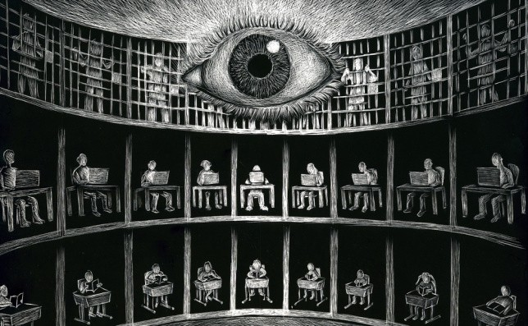
Panopticon

Slide 46
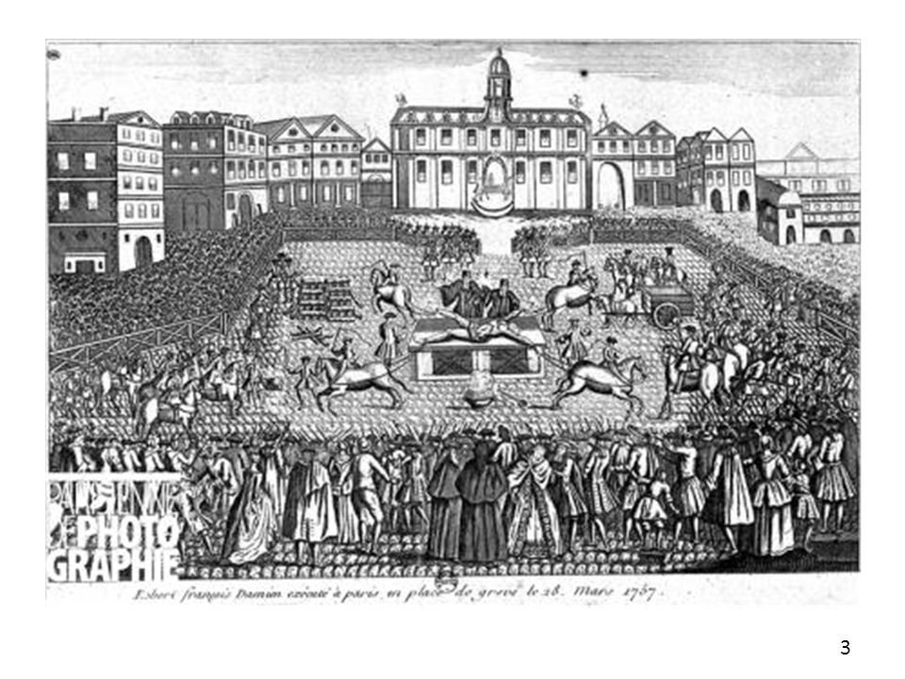
Surveil and Punish

Slide 47
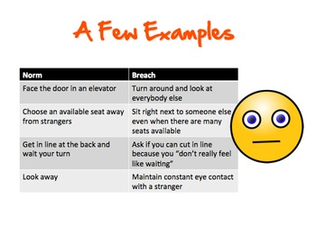
Fragility of Social Order

Slide 48
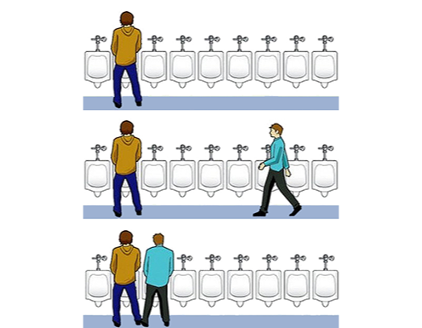
Senses of the Awkward

Slide 50
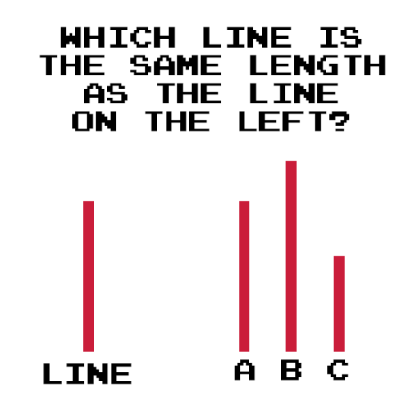
Conformity

